Slide 1
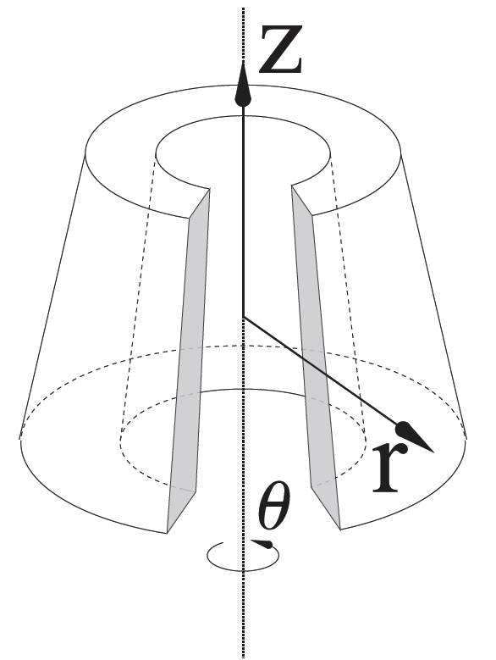
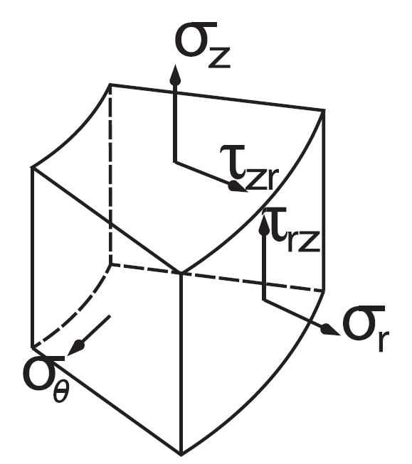
Axisymmetric project
Derek Lontine
Stuart Childs
Alex Bailey

Slide 2
Axisymmetric Quad Elements
Analytical Formulation
Computational Implementation
Verification Testing
Loading Schemes & Analytical Solutions
FEM Solutions
Error Analysis
Tests

Slide 3

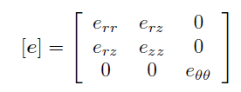

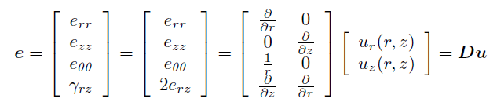
Analytical Formulation

Slide 4
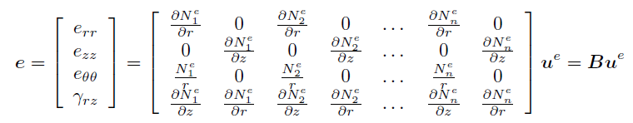
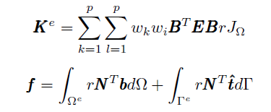
Analytical Formulation
[K]{u}={f}

Slide 5
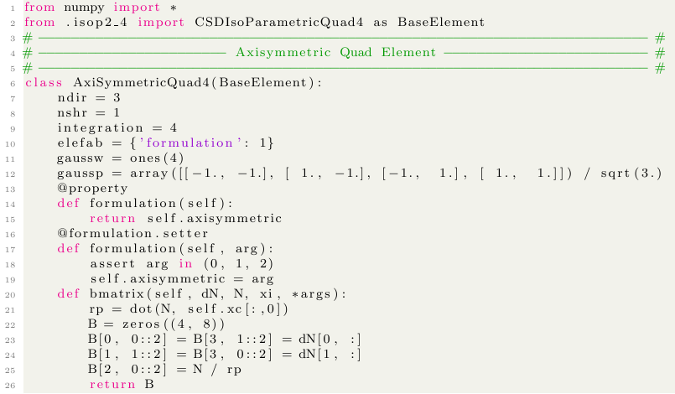
CSDAX4F: Continuum Stress-Displacement, Axisymmetric Quad 4, Full Integration

Slide 6
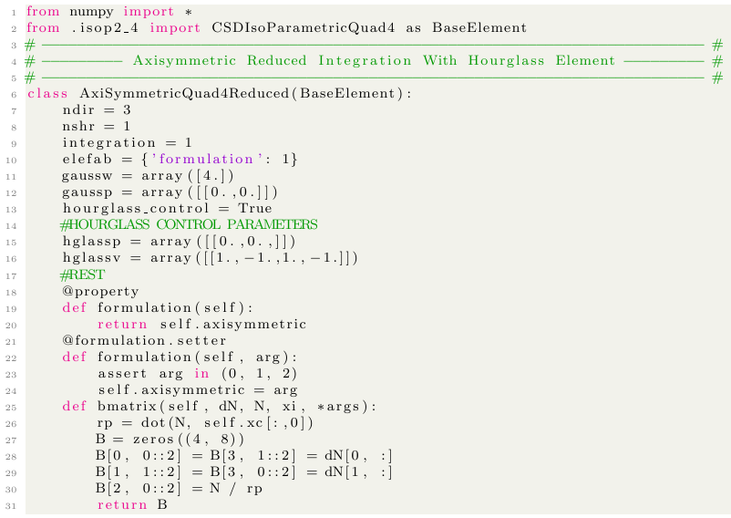
CSDAX4R: Continuum Stress-Displacement, Axisymmetric Quad 4, Reduced Integration

Slide 7
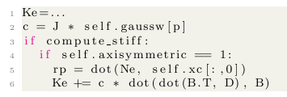
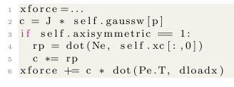
Modify the Stiffness
Fellipa Formulation
Also did similar addition of r for hourglass control, selective reduced integration functions

Slide 8
Verification Testing Process
Find Specific Value From a Given Stress Displacement Problem
Method
Finite Element Solution
Analytic Solution
FEA Answer
Refine Mesh
Analytic Answer
Converged
Obtain Error
Yes
Appropriate?
No

Slide 9
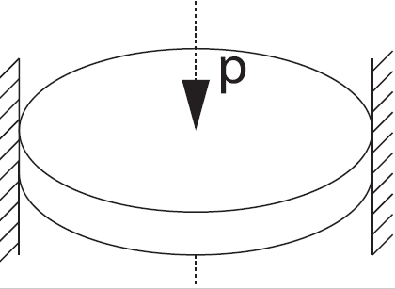
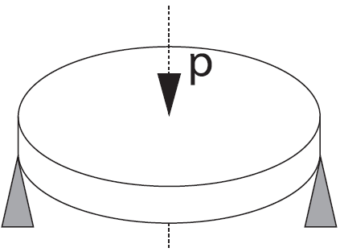
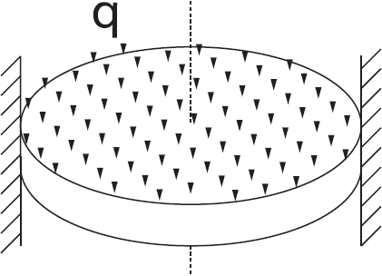
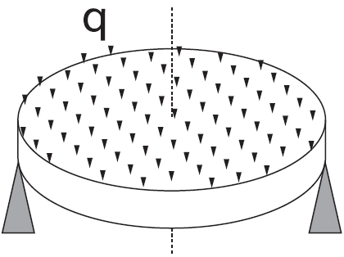
Problems with Analytical Solution:

Slide 10
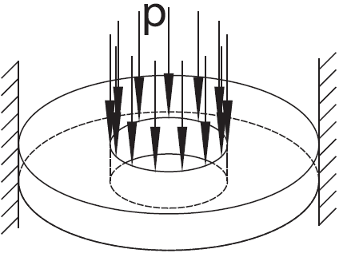
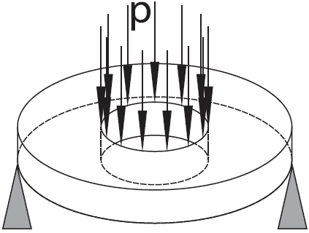
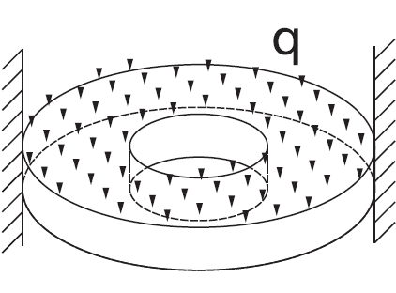
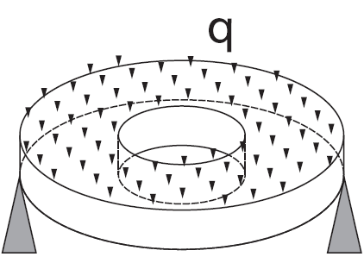
Problems with Analytical Solution:

Slide 11
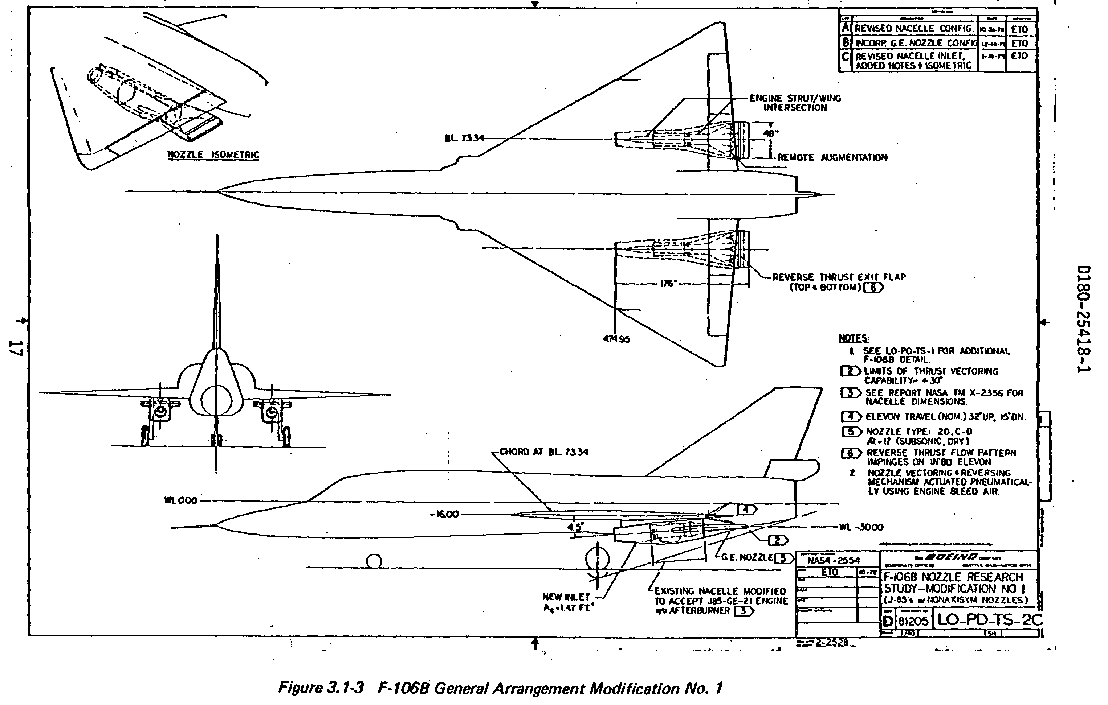
One last problem:

Slide 12
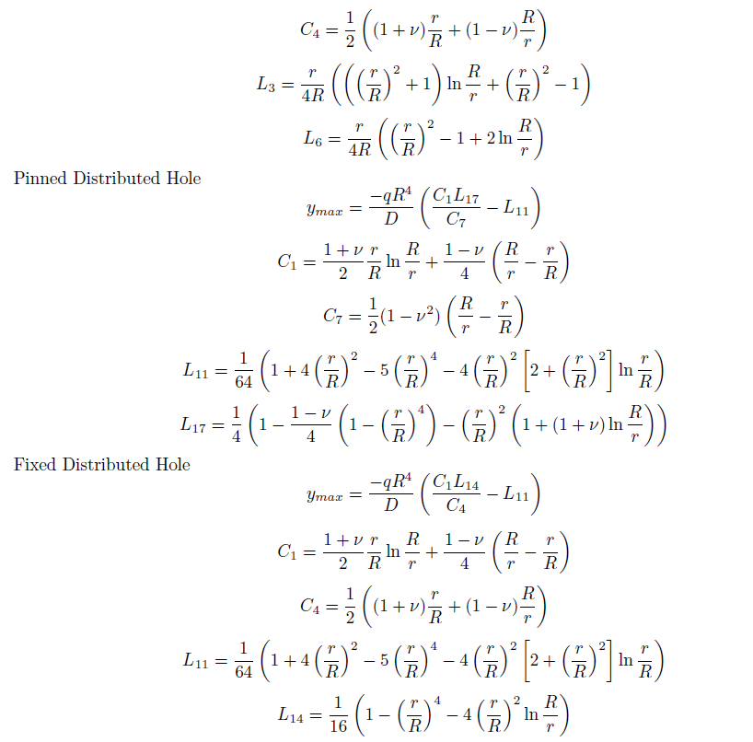
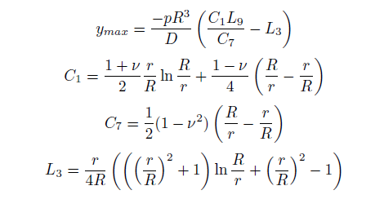
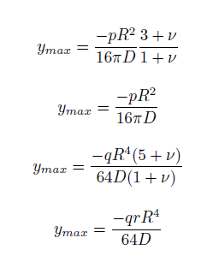

*Roark’s Formulas for Stress and Strain
Young, Budynas 2002 (1989)

Slide 13
Parameters to Solve:
Element Variables:
Integration order/element type (#of GP)
Formulation type (Santos/Fellipa)
Hourglass Control
Problem Parameters:
E, v
[ID], OD, thickness
Test Types:
Pinned vs fixed boundary
Concentrated vs distributed load
Plate vs washer geometry
8 total tests

Slide 14
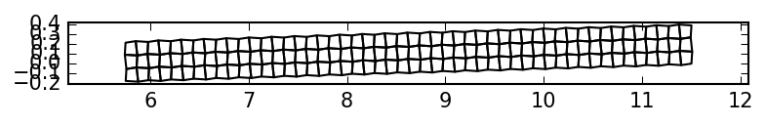
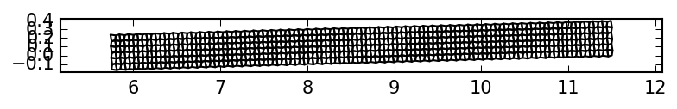
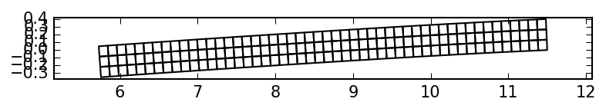
Mesh Deformations

Slide 15
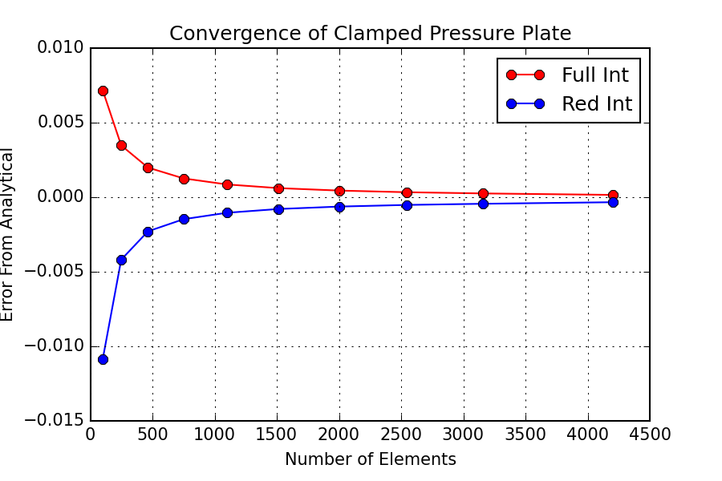
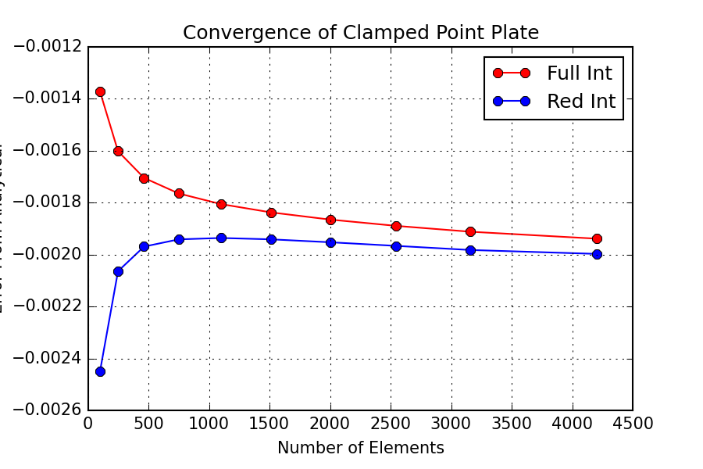
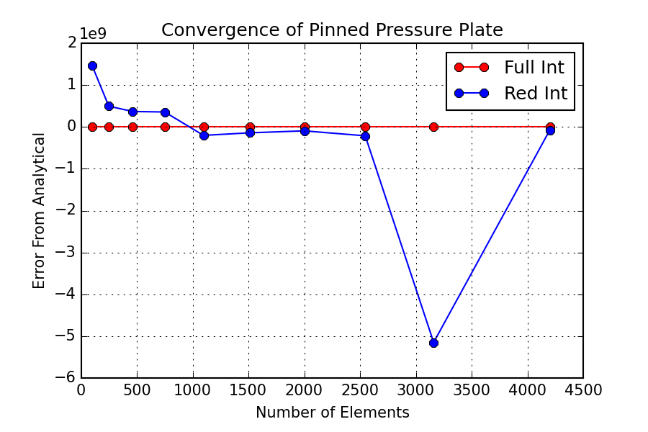
Error Analysis

Slide 16
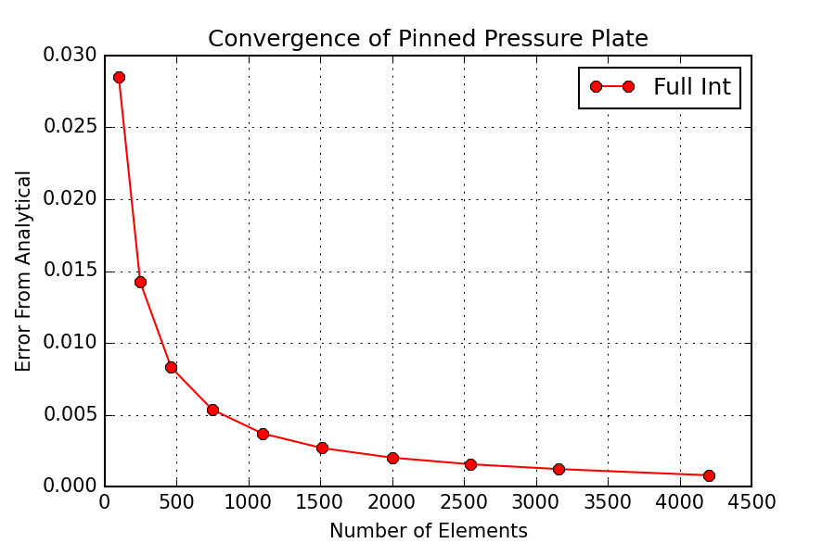
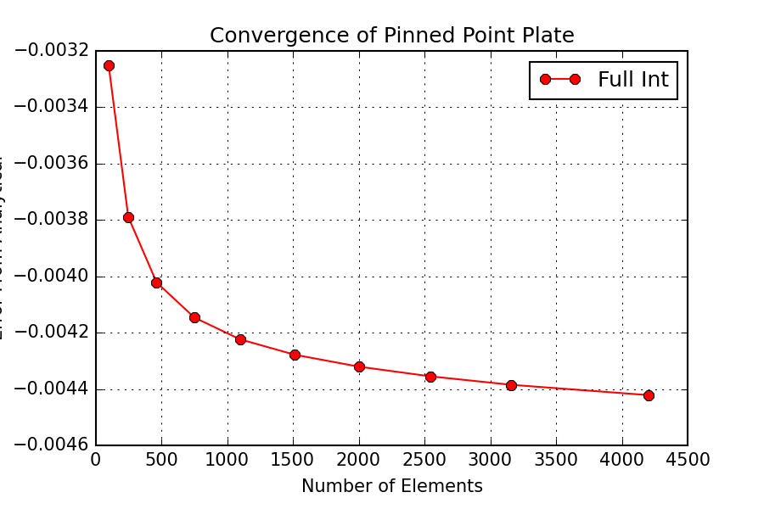
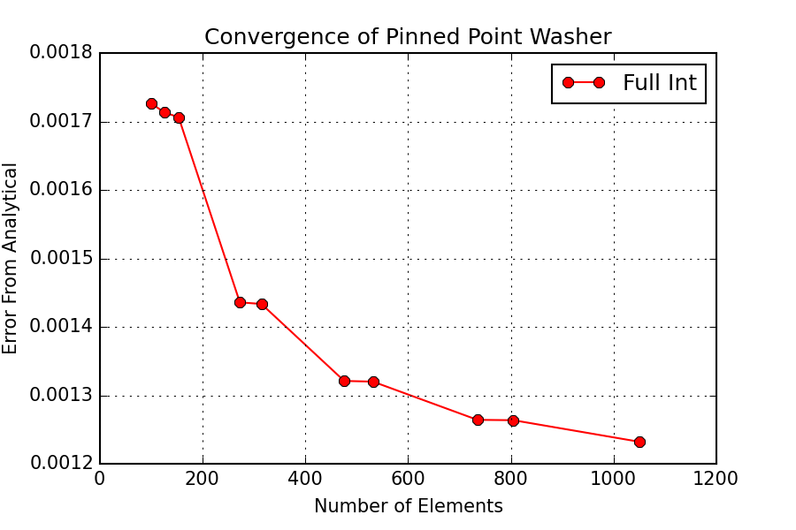
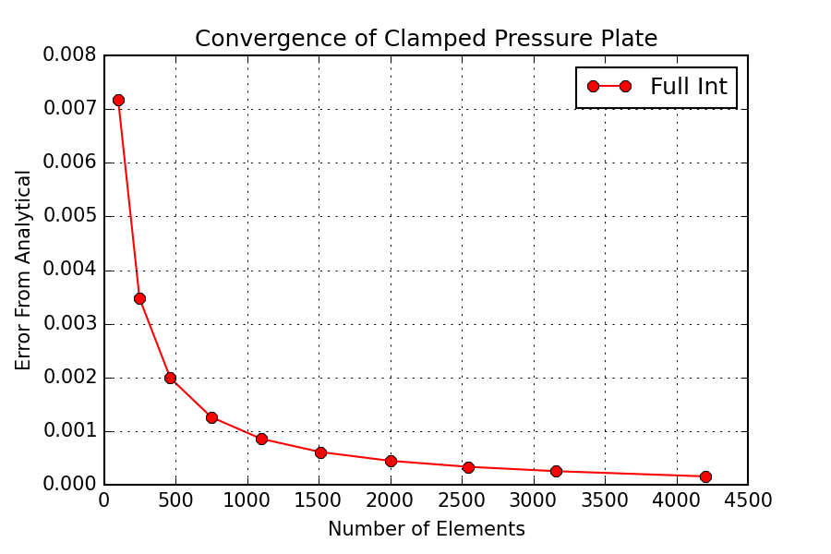
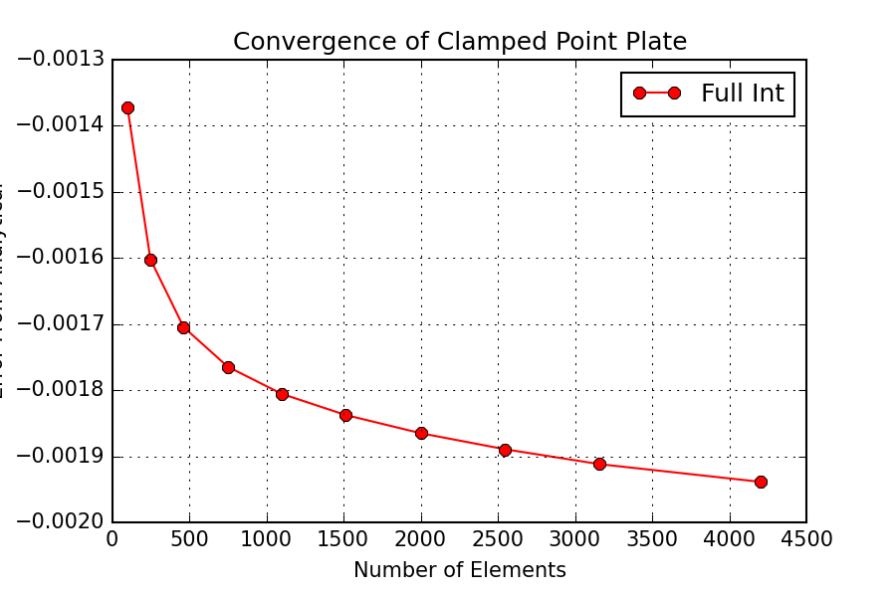
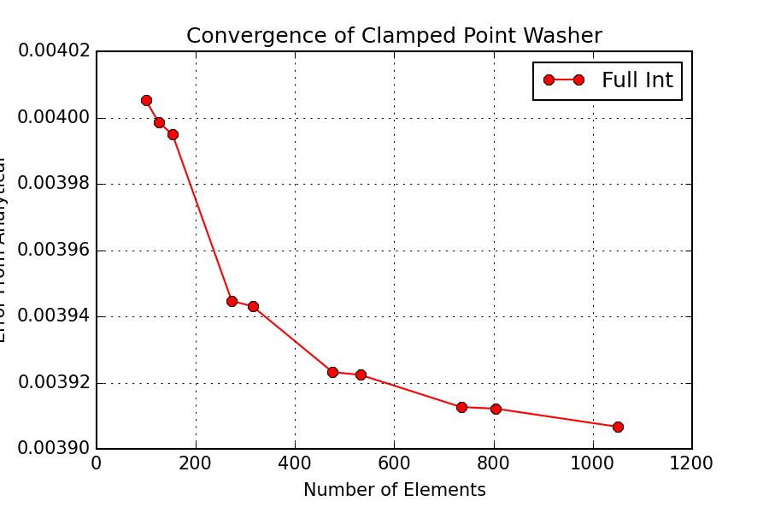
Error Analysis

